Slide 1
INDEX
Student Profile
Project Problem Statement
Project Pain Points
Approach Adopted
Techniques and Tools
Analysis Section
Conclusions

Slide 2

Student Profile
Shubham Shimpi
Aspiring Data Analyst
EDUCATION:-
Bachelor of Computer Application (BCA)
TECHNICAL SKILLS:-
Python
EDA
SQL
PySpark
Statistics
Power BI
HTML
Machine Learning
NLP
PROJECT:-
Capstone :- Bank Marketing Analysis

Slide 3
Project Problem Statement
The data is related with direct marketing campaigns of a Portuguese banking institution. The marketing campaigns were based on phone calls. Often, more than one contact to the same client was required, in order to access if the product (bank term deposit) would be ('yes') or not ('no') subscribed.
What to achieve?
The classification goal is to predict if the client will subscribe a term deposit (variable y).

Slide 4
Project Pain Points
Terms and Conditions Are Failing
Dispute Processes Not Up To Speed
Legacy Loan Deferment Systems Are Too Slow
Account Transfers Adding Grief
Replacement Card Processes Too Complex
Fraud Resolution Held Up By Friction

Slide 5
Approach Adopted
Import data from dataset and perform initial high-level analysis: look at the number of rows, look at the missing values, look at dataset columns and their values respective to the campaign outcome.
Clean the data: remove irrelevant columns, deal with missing and incorrect values, turn categorical columns into dummy variables.

Slide 6
Techniques and Tools
TOOLS
import linear algebra and data manipulation libraries
numpy
pandas
import standard visualization
matplotlib
seaborn
TECHNIQUES
Exploration Data Analysis
Data Cleaning
Fill Missing Values

Slide 7
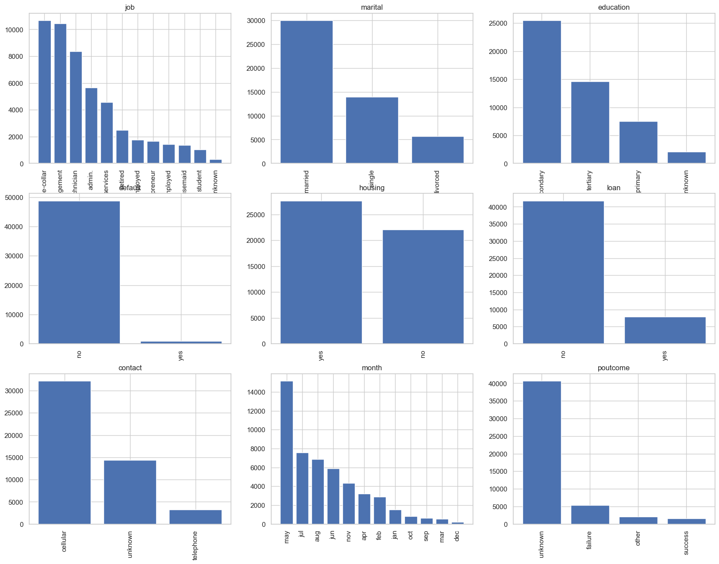
Analysis Section
Numerical columns exploration
Now let's look at the numerical columns' values. The most convenient way to look at the numerical values is plotting histograms.

Slide 8
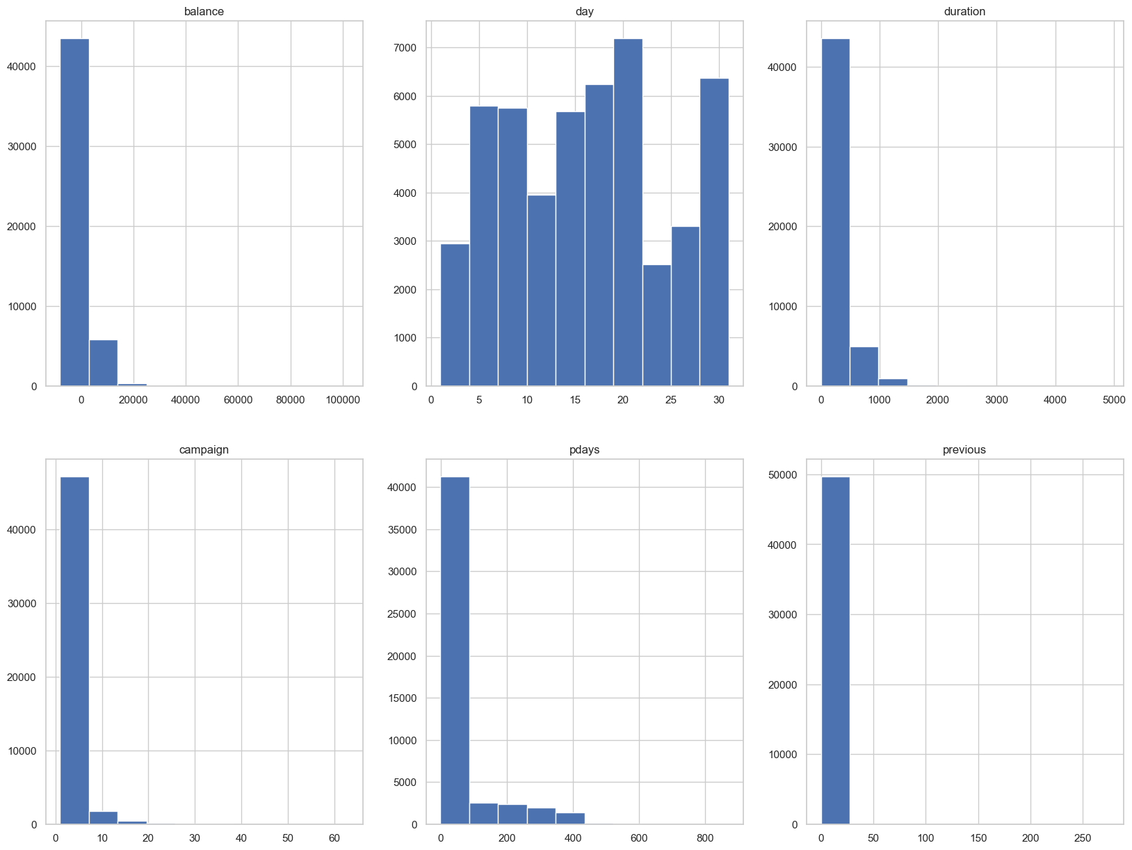
We can see that numerical columns have outliers (especially ‘pdays', 'campaign' and 'previous' columns). Possibly there are incorrect values (noisy data), so we should look closer at the data and decide how do we manage the noise. Let's look closer at the values of 'campaign', 'pdays' and 'previous' columns:

Slide 9
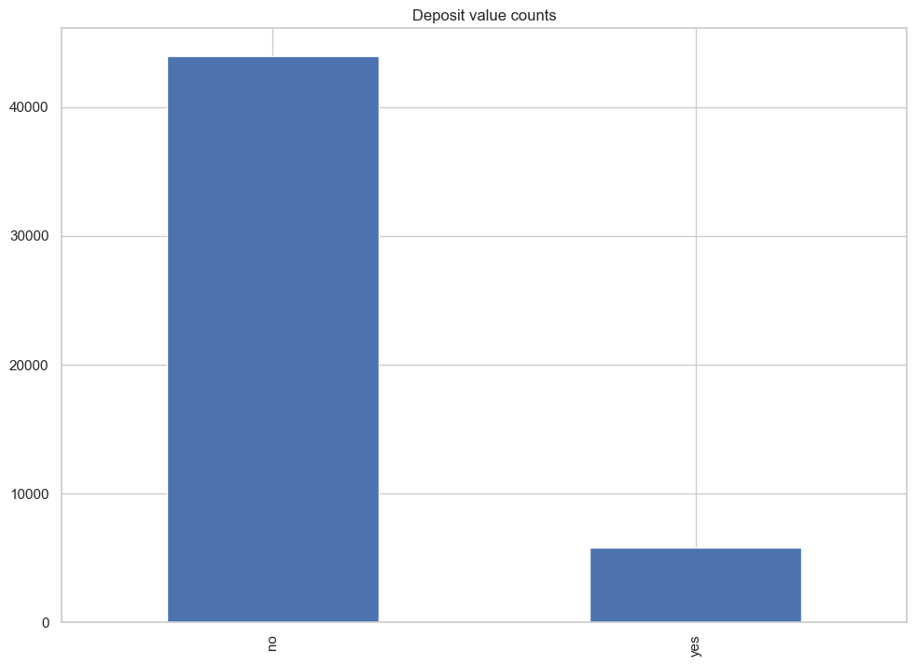
On the diagram we see that counts for 'yes' and 'no' values for 'y' are very high difference. It's not a close
Let's see how 'deposit' column value varies depending on other categorical columns' values:

Slide 10
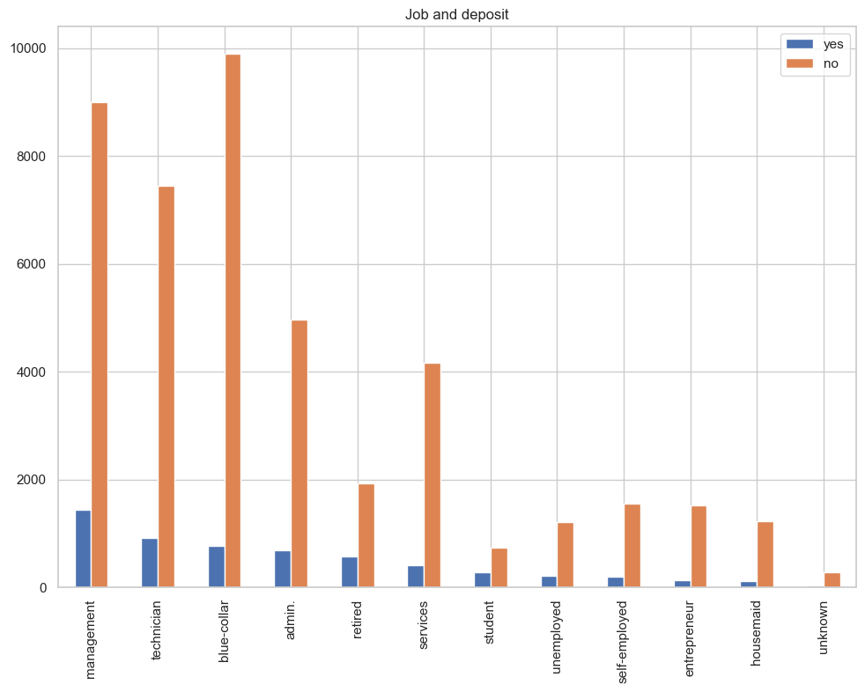

Slide 11
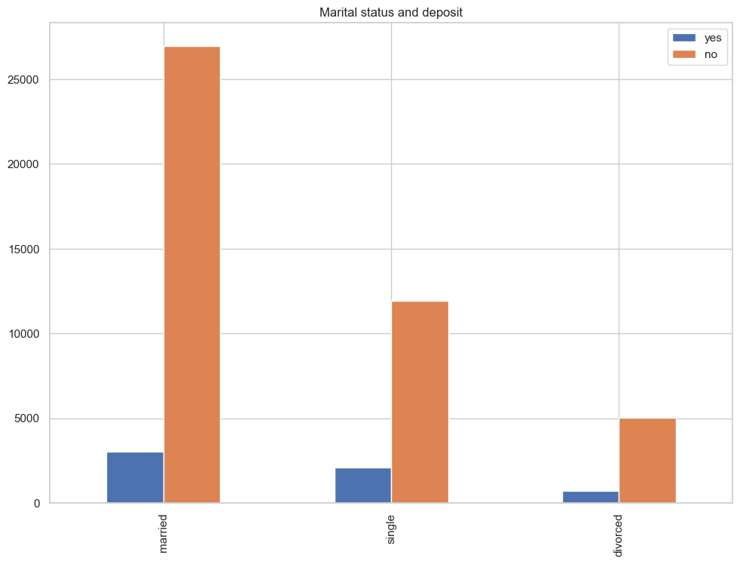

Slide 12
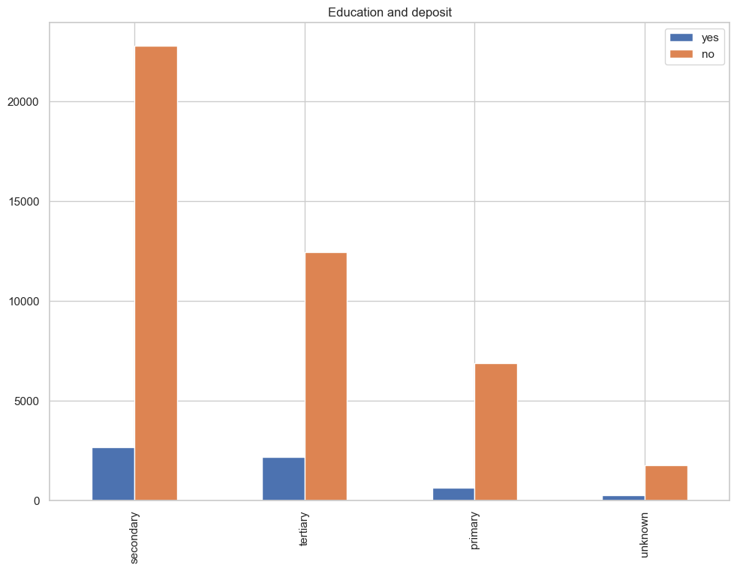

Slide 13
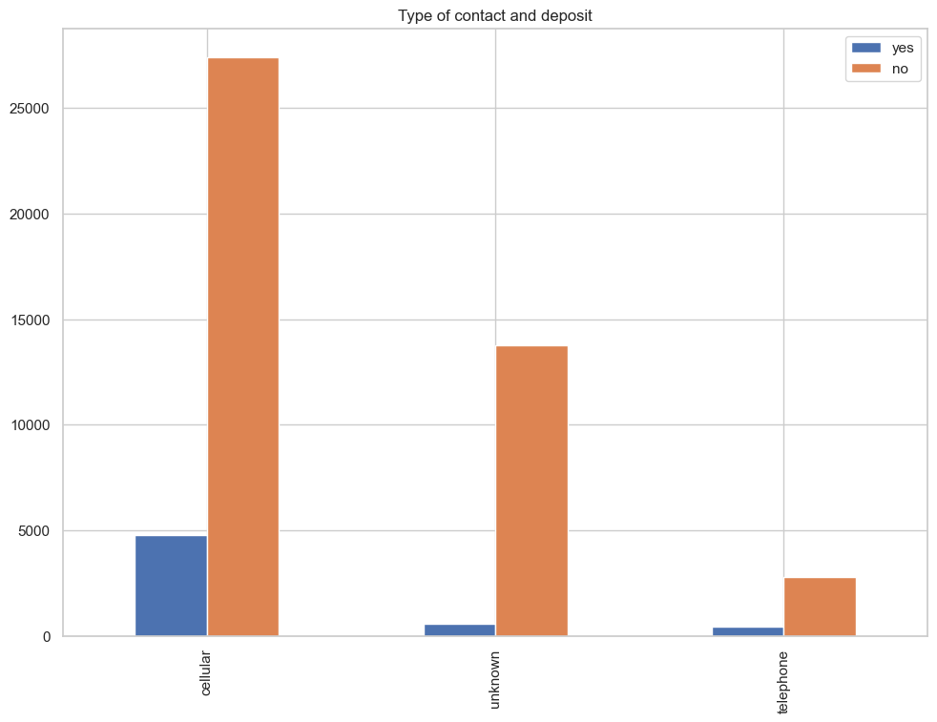
Regarding the diagrams we can tell that according to our dataset:
1.Customers with 'blue-collar' and 'services' jobs are less likely to subscribe for term deposit.
2.Married customers are less likely to subscribe for term deposit.
3.Customers with 'cellular' type of contact are less likely to subscribe for term deposit.
Now let's look how numerical columns affect term deposit subscription.

Slide 14
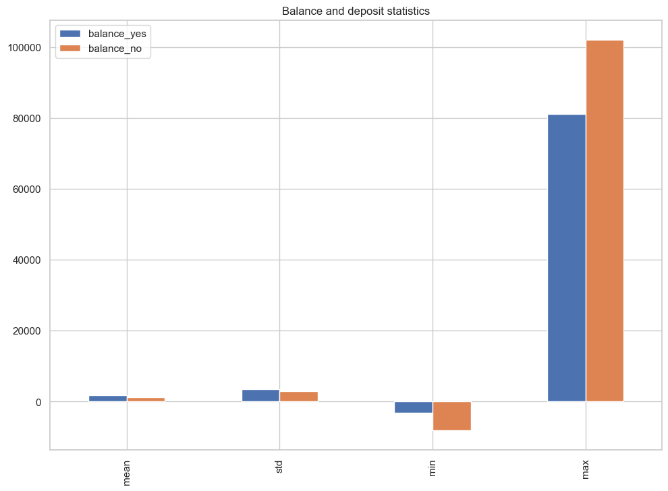

Slide 15
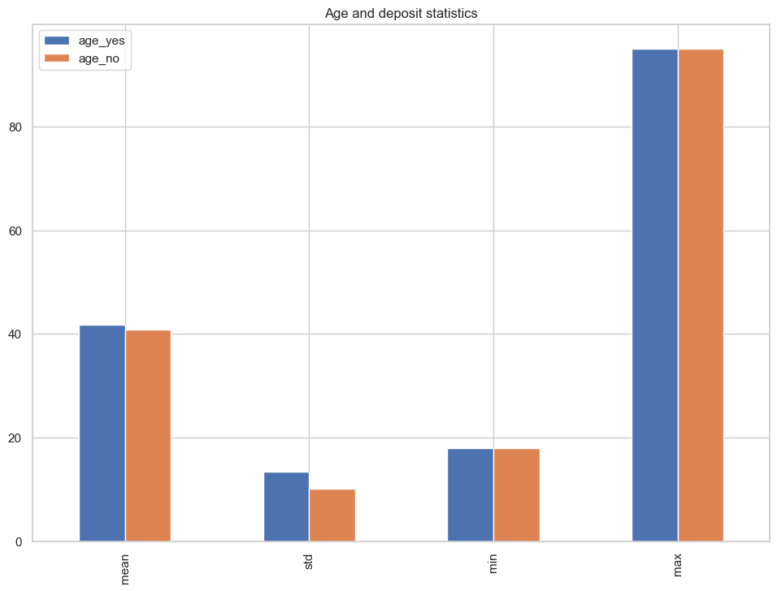

Slide 16
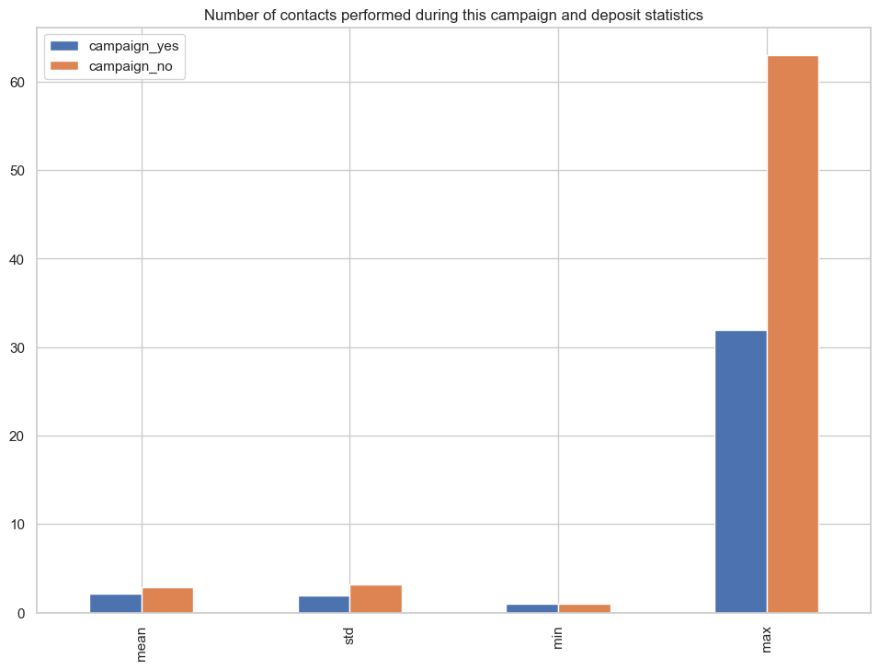

Slide 17
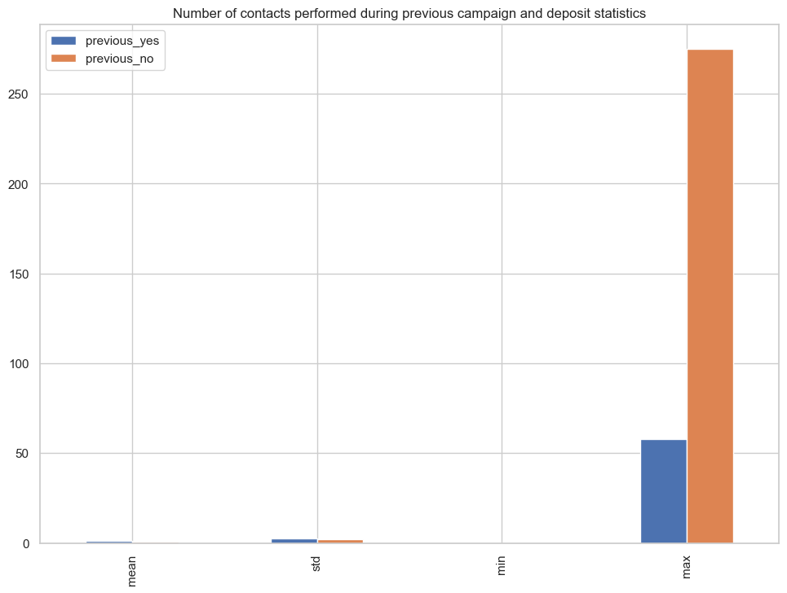
Looking at the diagrams above we can conclude that:
People who subscribed for term deposit tend to have greater balance and age values.
People who subscribed for term deposit tend to have fewer number of contacts during this campaign.

Slide 18
Conclusions
Key outcomes of the analysis are the recommendations for future marketing campaigns:
The customer's account balance has a huge influence on the campaign's outcome. People with account balance above 1490$ are more likely to subscribe for term deposit, so future address those customers.
The customer's age affects campaign outcome as well. Future campains should concentrate on customers from age categories below 30 years old and above 50 years old.
Number of contacts with the customer during the campaign is also very important. The number of contacts with the customer shouldn't exceed 4.

